Slide 1
MCUXpresso Software and Tools
ARM Cortex M Software Solutions

Slide 2
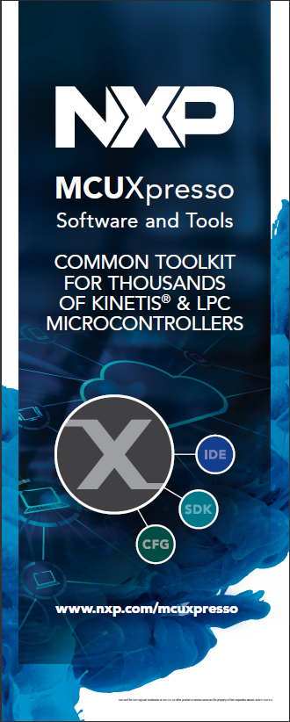




MCUXpresso Software and Tools
for LPC & Kinetis MCUs and i.MX RT crossover processors
MCUXpresso IDE Edit, compile, debug and optimize in an intuitive and powerful IDE
MCUXpresso SDK Runtime software including peripheral drivers, middleware, RTOS, demos and more
MCUXpresso Config Tools Online and desktop tool suite for system configuration and optimization

Slide 3

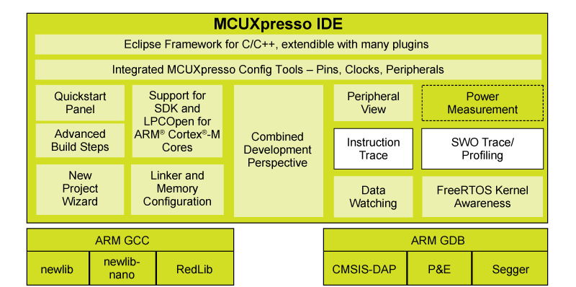
Learn more at: www.nxp.com/mcuxpresso/ide
MCUXpresso IDE
Free Eclipse and GCC-based IDE for C/C++ development on Kinetis and LPC MCUs
Product Features
Feature-rich, unlimited code size, optimized for ease-of-use, based on industry standard Eclipse framework for NXP’s Kinetis and LPC MCUs and i.MX RT crossover processors
Application development with Eclipse and GCC-based IDE for advanced editing, compiling and debugging
Supports custom development boards, Freedom, Tower and LPCXpresso boards with debug probes from NXP, P&E and Segger
Free: Full Featured, unlimited Code Size, no special activation needed, community based support

Slide 4





Learn more at: www.nxp.com/mcuxpresso/sdk
MCUXpresso SDK
The software framework and reference for Kinetis & LPC MCU application development
Product Features
Architecture:
CMSIS-CORE compatible
Single driver for each peripheral
Transactional APIs w/ optional DMA support for communication peripherals
Integrated RTOS:
FreeRTOS v9, Amazon FreeRTOS
RTOS-native driver wrappers
Integrated Stacks and Middleware
USB Host, Device and OTG
lwIP, FatFS
Crypto acceleration plus wolfSSL & mbedTLS
SD and eMMC card support
Reference Software:
Peripheral driver usage examples
Application demos
FreeRTOS usage demos
License:
Clear BSD 3-clause for startup, drivers, USB stack
Toolchains:
MCUXpresso IDE
IAR®, ARM® Keil®, GCC w/ Cmake
Quality
Production-grade software
MISRA 2004 compliance
Checked with Coverity® static analysis tools
Application Code
Stacks /
Middleware
Board Support
RTOS
Peripheral Drivers
CMSIS-CORE and CMSIS-DSP
Microcontroller Hardware

Slide 5



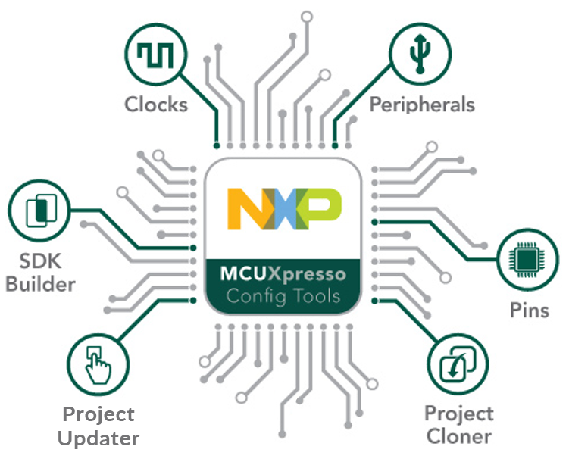
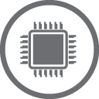




Learn more at: www.nxp.com/mcuxpresso/config
MCUXpresso Config Tools
Integrated configuration and development tools for LPC and Kinetis MCUs
Product Features
SDK Builder packages custom SDKs based on user selections of MCU, evaluation board, and optional software components.
Pins, Clocks, and Peripheral tools generate initialization C code for custom board support. Features validation of inputs and cross-tool conflict resolution.
Project Update works directly with existing SDK-based IDE projects with generated Pins, Clocks, and Peripheral source files.
Project Cloning creates a standalone SDK project based on a example application available within SDK release.

Slide 6
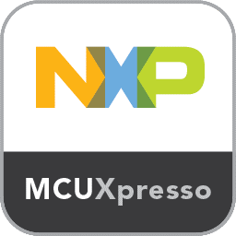
MCUXpresso SW and Tool Release Overview
MCUXpresso SW and Tools launched on March 2017
Comprised of three primary tools: SDK, IDE, and Config Tools
Major releases targeted for twice a year (Q2 / Q4)
Next major release date scheduled for May 2018
Current Release: SDK v2.4.0
Support for current Kinetis, LPC, and i.MX RT devices
New device support released throughout year as required to support device availability.
Major semi-annual releases include updated drivers, middleware releases, and improvements
Current Release: IDE v10.1.1
Support for current Kinetis, LPC, and i.MX RT devices
Additional support for legacy LPC devices
Device support is included via SDK releases.
Major semi-annual releases include updated eclipse framework, compiler versions, and performance improvements
Current Release: Config Tool v4.0
Include configuration for Pins, Clocks, and key Peripherals
New device data and peripheral support released throughout year, tool will update when connected online
Major semi-annual releases include new features, additional peripheral support, and workflow improvements

Slide 7
MCUXpresso Software and Tools Additional Resources
Web pages
MCUXpresso Software and Tools – www.nxp.com/mcuxpresso
MCUXpresso SDK – www.nxp.com/mcuxpresso/sdk
MCUXpresso IDE – www.nxp.com/mcuxpresso/ide
MCUXpresso Config Tools – www.nxp.com/mcuxpresso/config
Supported Devices
Supported Devices Table (Community Doc)
Communities
MCUXpresso Software and Tools - https://community.nxp.com/community/mcuxpresso
MCUXpresso SDK: https://community.nxp.com/community/mcuxpresso/mcuxpresso-sdk
MCUXpresso IDE: https://community.nxp.com/community/mcuxpresso/mcuxpresso-ide
MCUXpresso Config Tools: https://community.nxp.com/community/mcuxpresso/mcuxpresso-config

Slide 8
Efficient Workflow

Slide 9
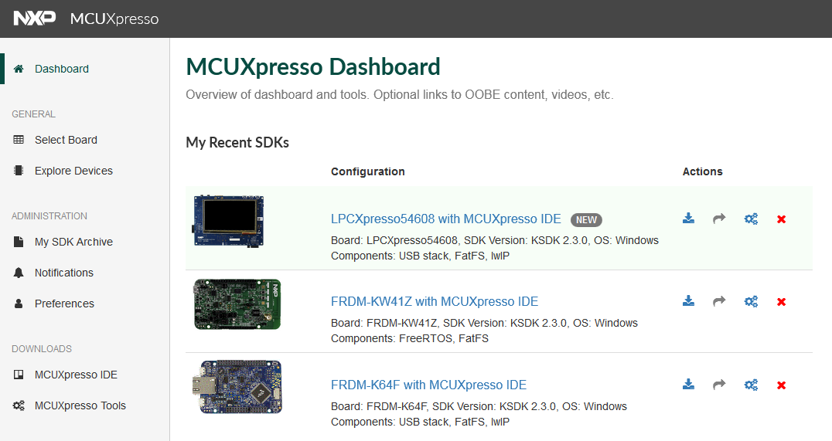
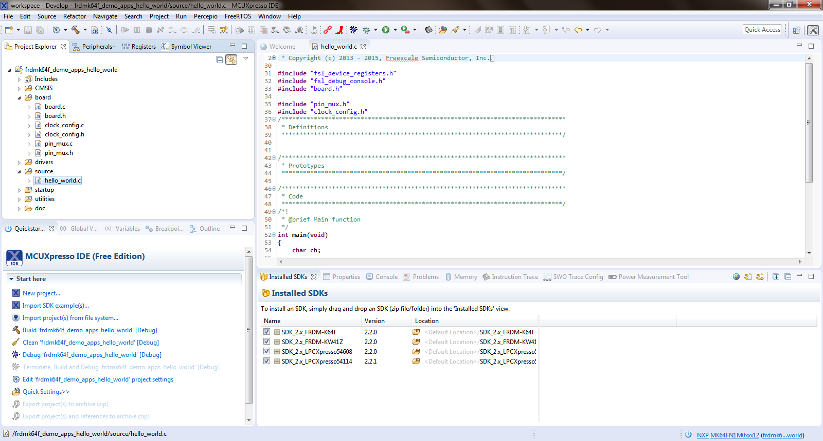

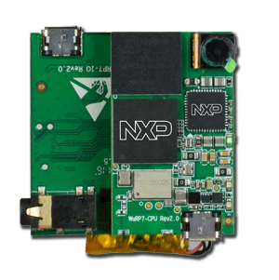
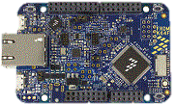

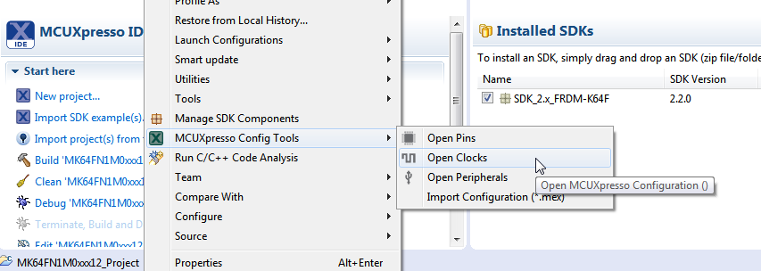
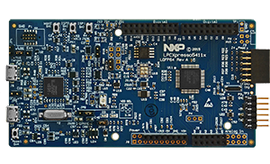
MCUXpresso SW and Tools Efficient Development Flow
Online Custom SDK Builder
Drag-and-Drop installation of SDK into IDE
SDK Project Importing / Cloning
Demo applications, SDK driver examples, middleware use case projects
Management of SDK drivers and middleware components
Integrated Config Tools
Pins and Clocks initialization for user defined boards
Examples,
Demo Apps

Slide 10
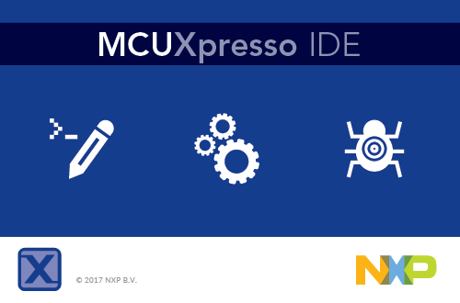
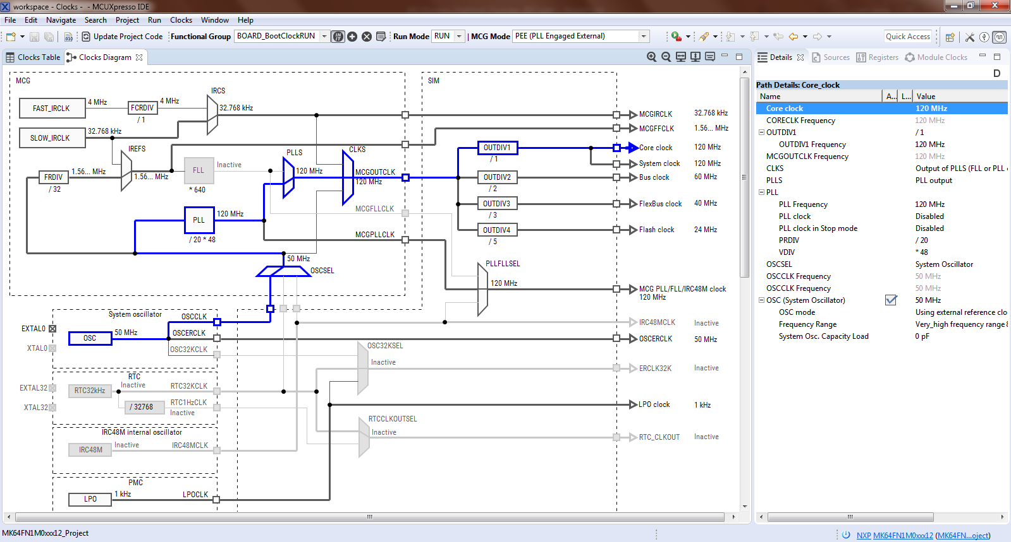
MCUXpresso IDE
MCUXpresso SDK Installation
Development Perspective
Integrated MCUXpresso Config Tools

Slide 11
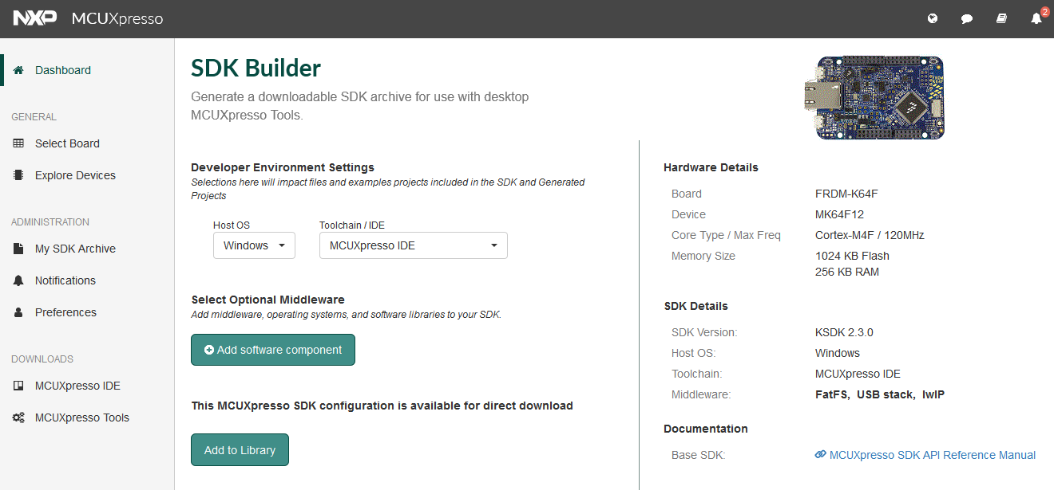
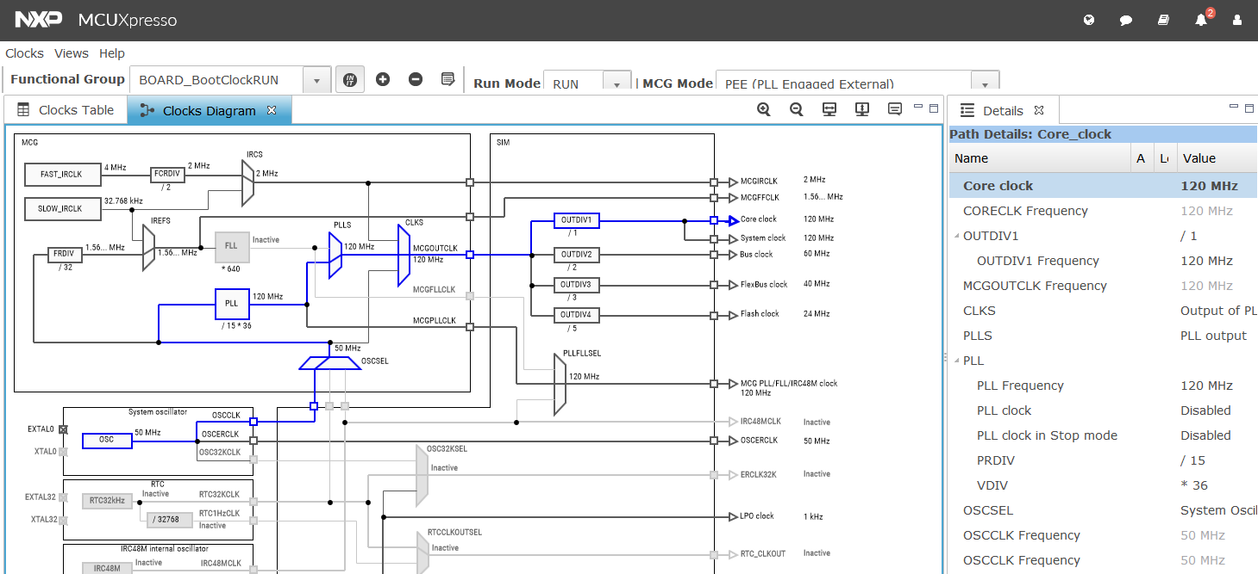
MCUXpresso SDK Builder (http://mcuxpresso.nxp.com)
MCUXpresso Dashboard
MCUXpresso SDK Builder
Online MCUXpresso Config Tools

Slide 12
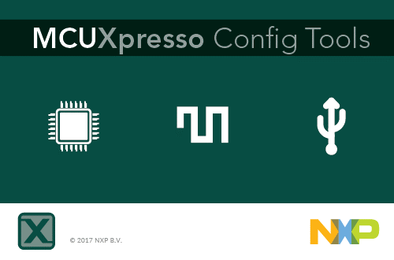
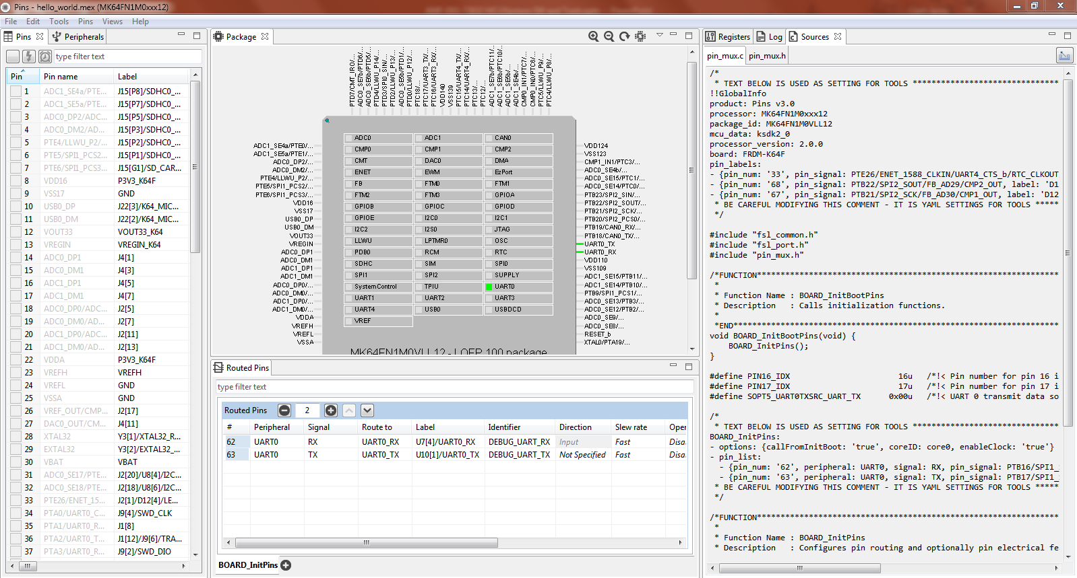
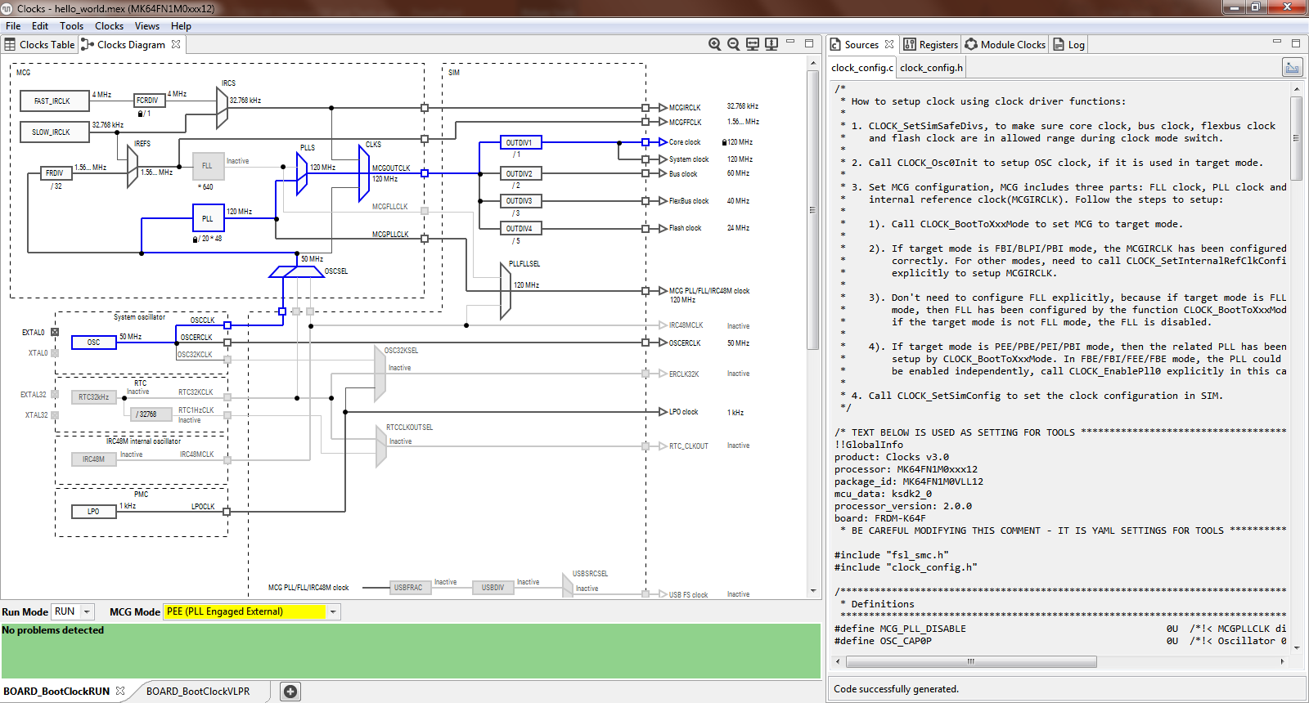
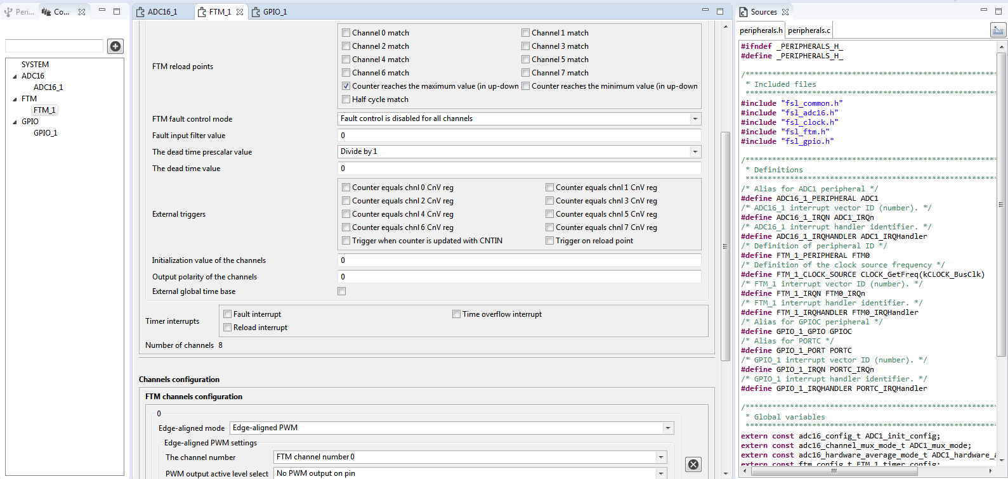
MCUXpresso Config Tools
Pins, Clock, and Peripheral Initialization
Code Generation
Conflict Resolution

Slide 13
Walk-thru / Demo

Slide 14
Demo Overview
Create new MCUXpresso SDK project in MCUXpresso IDE
Launch integrated MCUXpresso Config Tools
Add Systick Timer / Delay to main application
Add LED (GPIO) using Pins and Peripheral Tool
Add GPIO Toggle to main application
Switch LED using Pins Tool
Add Pushbutton Switch (GPIO) using Pins and Peripheral Tool
Add IRQ routine to main application

Slide 15
Code Additions
Add SysTick Delay Timer
Global Variables / Functions:
/****** Start Copy Below ******/
static volatile uint32_t DelayTimerTick = 0;
/* SysTick Interrupt Handler */
void SysTick_Handler(void)
{
if (DelayTimerTick<0xFFFFFFFF) { DelayTimerTick++; } /* increment timer */
}
/* Delay Function based on SysTick Counter */
void Delay_SysTick(uint32_t SysTicks)
{
DelayTimerTick = 0; /* reset timer value */
while(DelayTimerTick < SysTicks); /* wait for timer */
}
/****** End Copy ******/
Main() Additions
/****** Start Copy Below ******/
SysTick_Config(120000); /* Configure the SysTick timer */
/****** End Copy ******/

Slide 16
Code Additions
Blinky LED
Important Details:
The code below assumes that you created and selected an identifier of “MY_LED” to the desired GPIO within the Pin Tool.
Main() Modifications
/****** Start Copy Below ******/
while (1)
{
/* Blink LED every 250 SysTicks */
Delay_SysTick(250);
GPIO_TogglePinsOutput(BOARD_INITPINS_MY_LED_GPIO, 1u << BOARD_INITPINS_MY_LED_GPIO_PIN);
}
/****** End Copy ******/

Slide 17
Code Additions
Interrupt Push Button
Important Details:
The code below assumes that you selected the identifier of “SW2” to the desired input GPIO within the Pin Tool, and specified a custom interrupt handler name of “push_button_irq” within the Peripheral Tool. The variable “g_count” can be viewed using the Live Variable feature of the IDE.
Global Variables:
/****** Start Copy Below ******/
static volatile uint32_t g_count = 0;
/****** End Copy ******/
Functions:
/****** Start Copy Below ******/
/* Interrupt Handler for GPIO Port C Pins */
void push_button_irq (void)
{
/* Clear external interrupt flag. */
GPIO_ClearPinsInterruptFlags(BOARD_INITPINS_SW2_GPIO, 1U << BOARD_INITPINS_SW2_GPIO_PIN);
g_count++; /* Increment counter */
}
/****** End Copy ******/

